Slide 1
Collections Painting

Slide 2
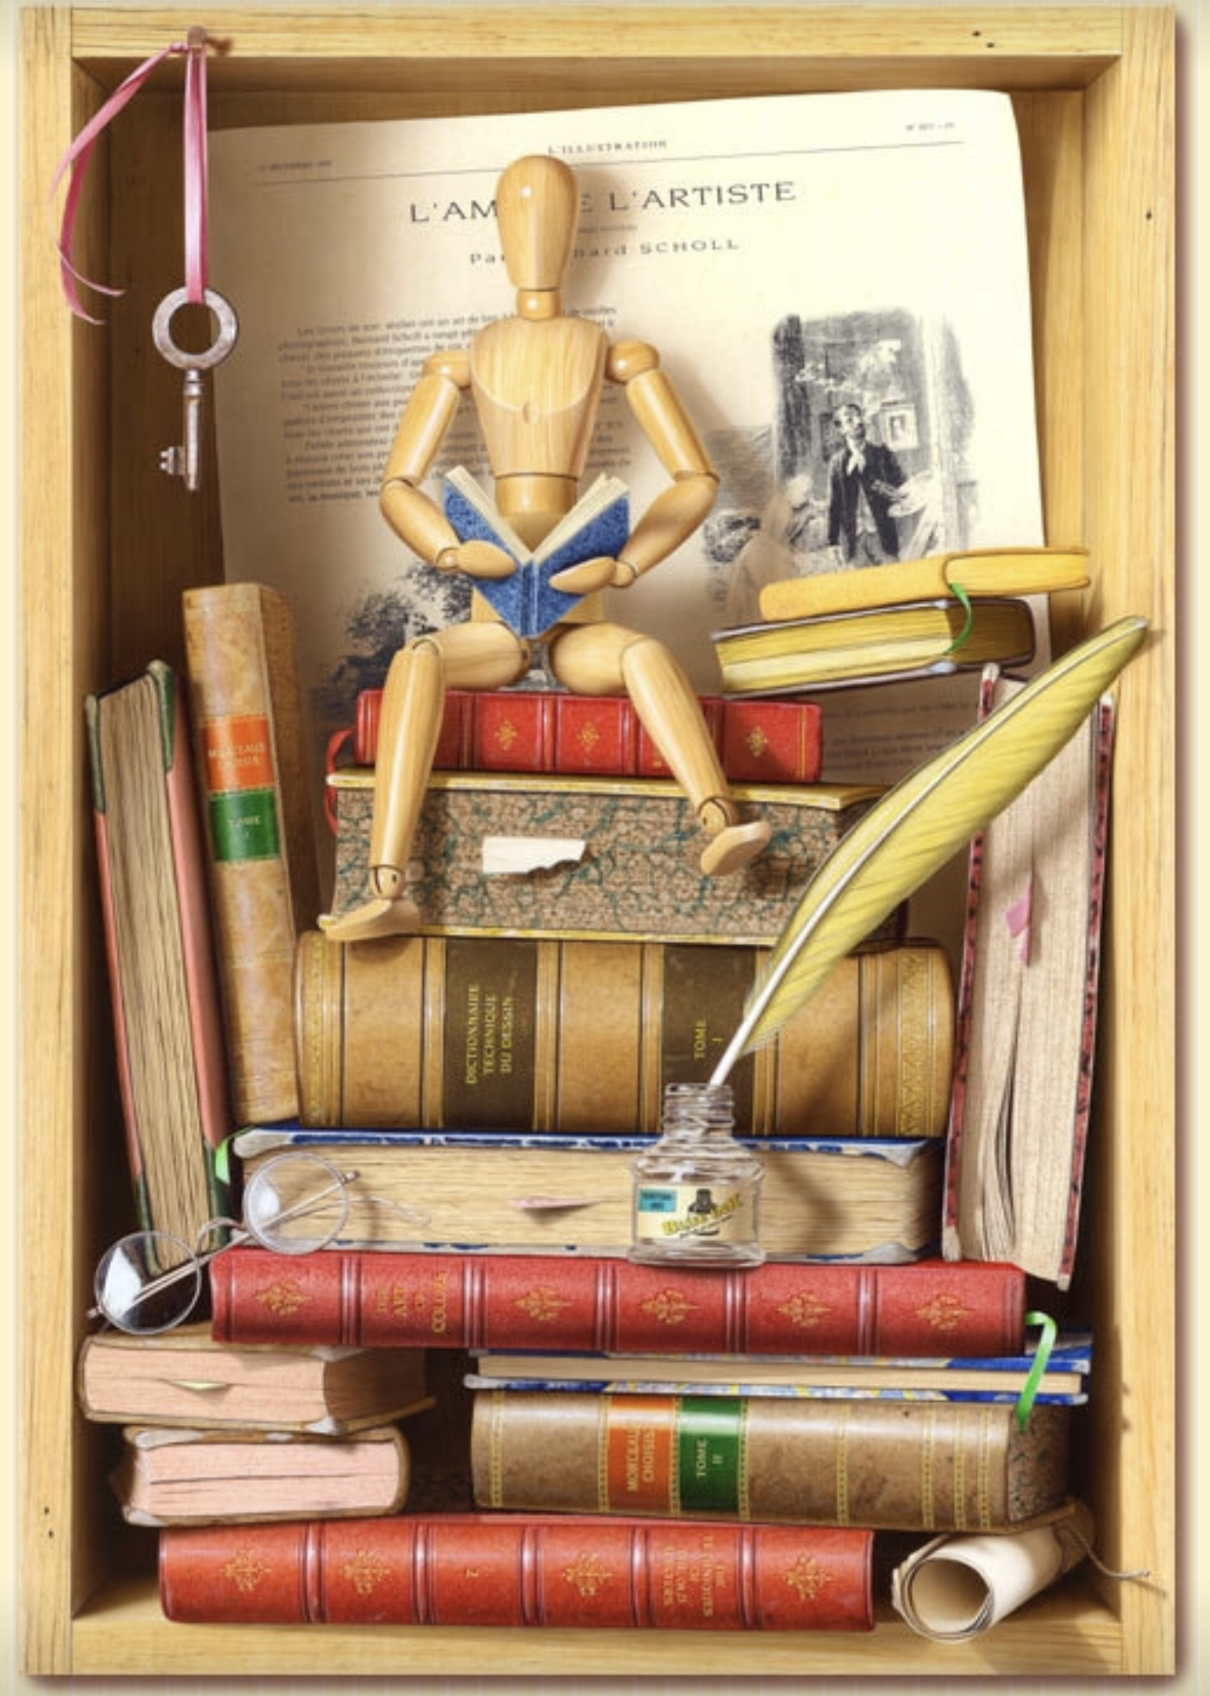
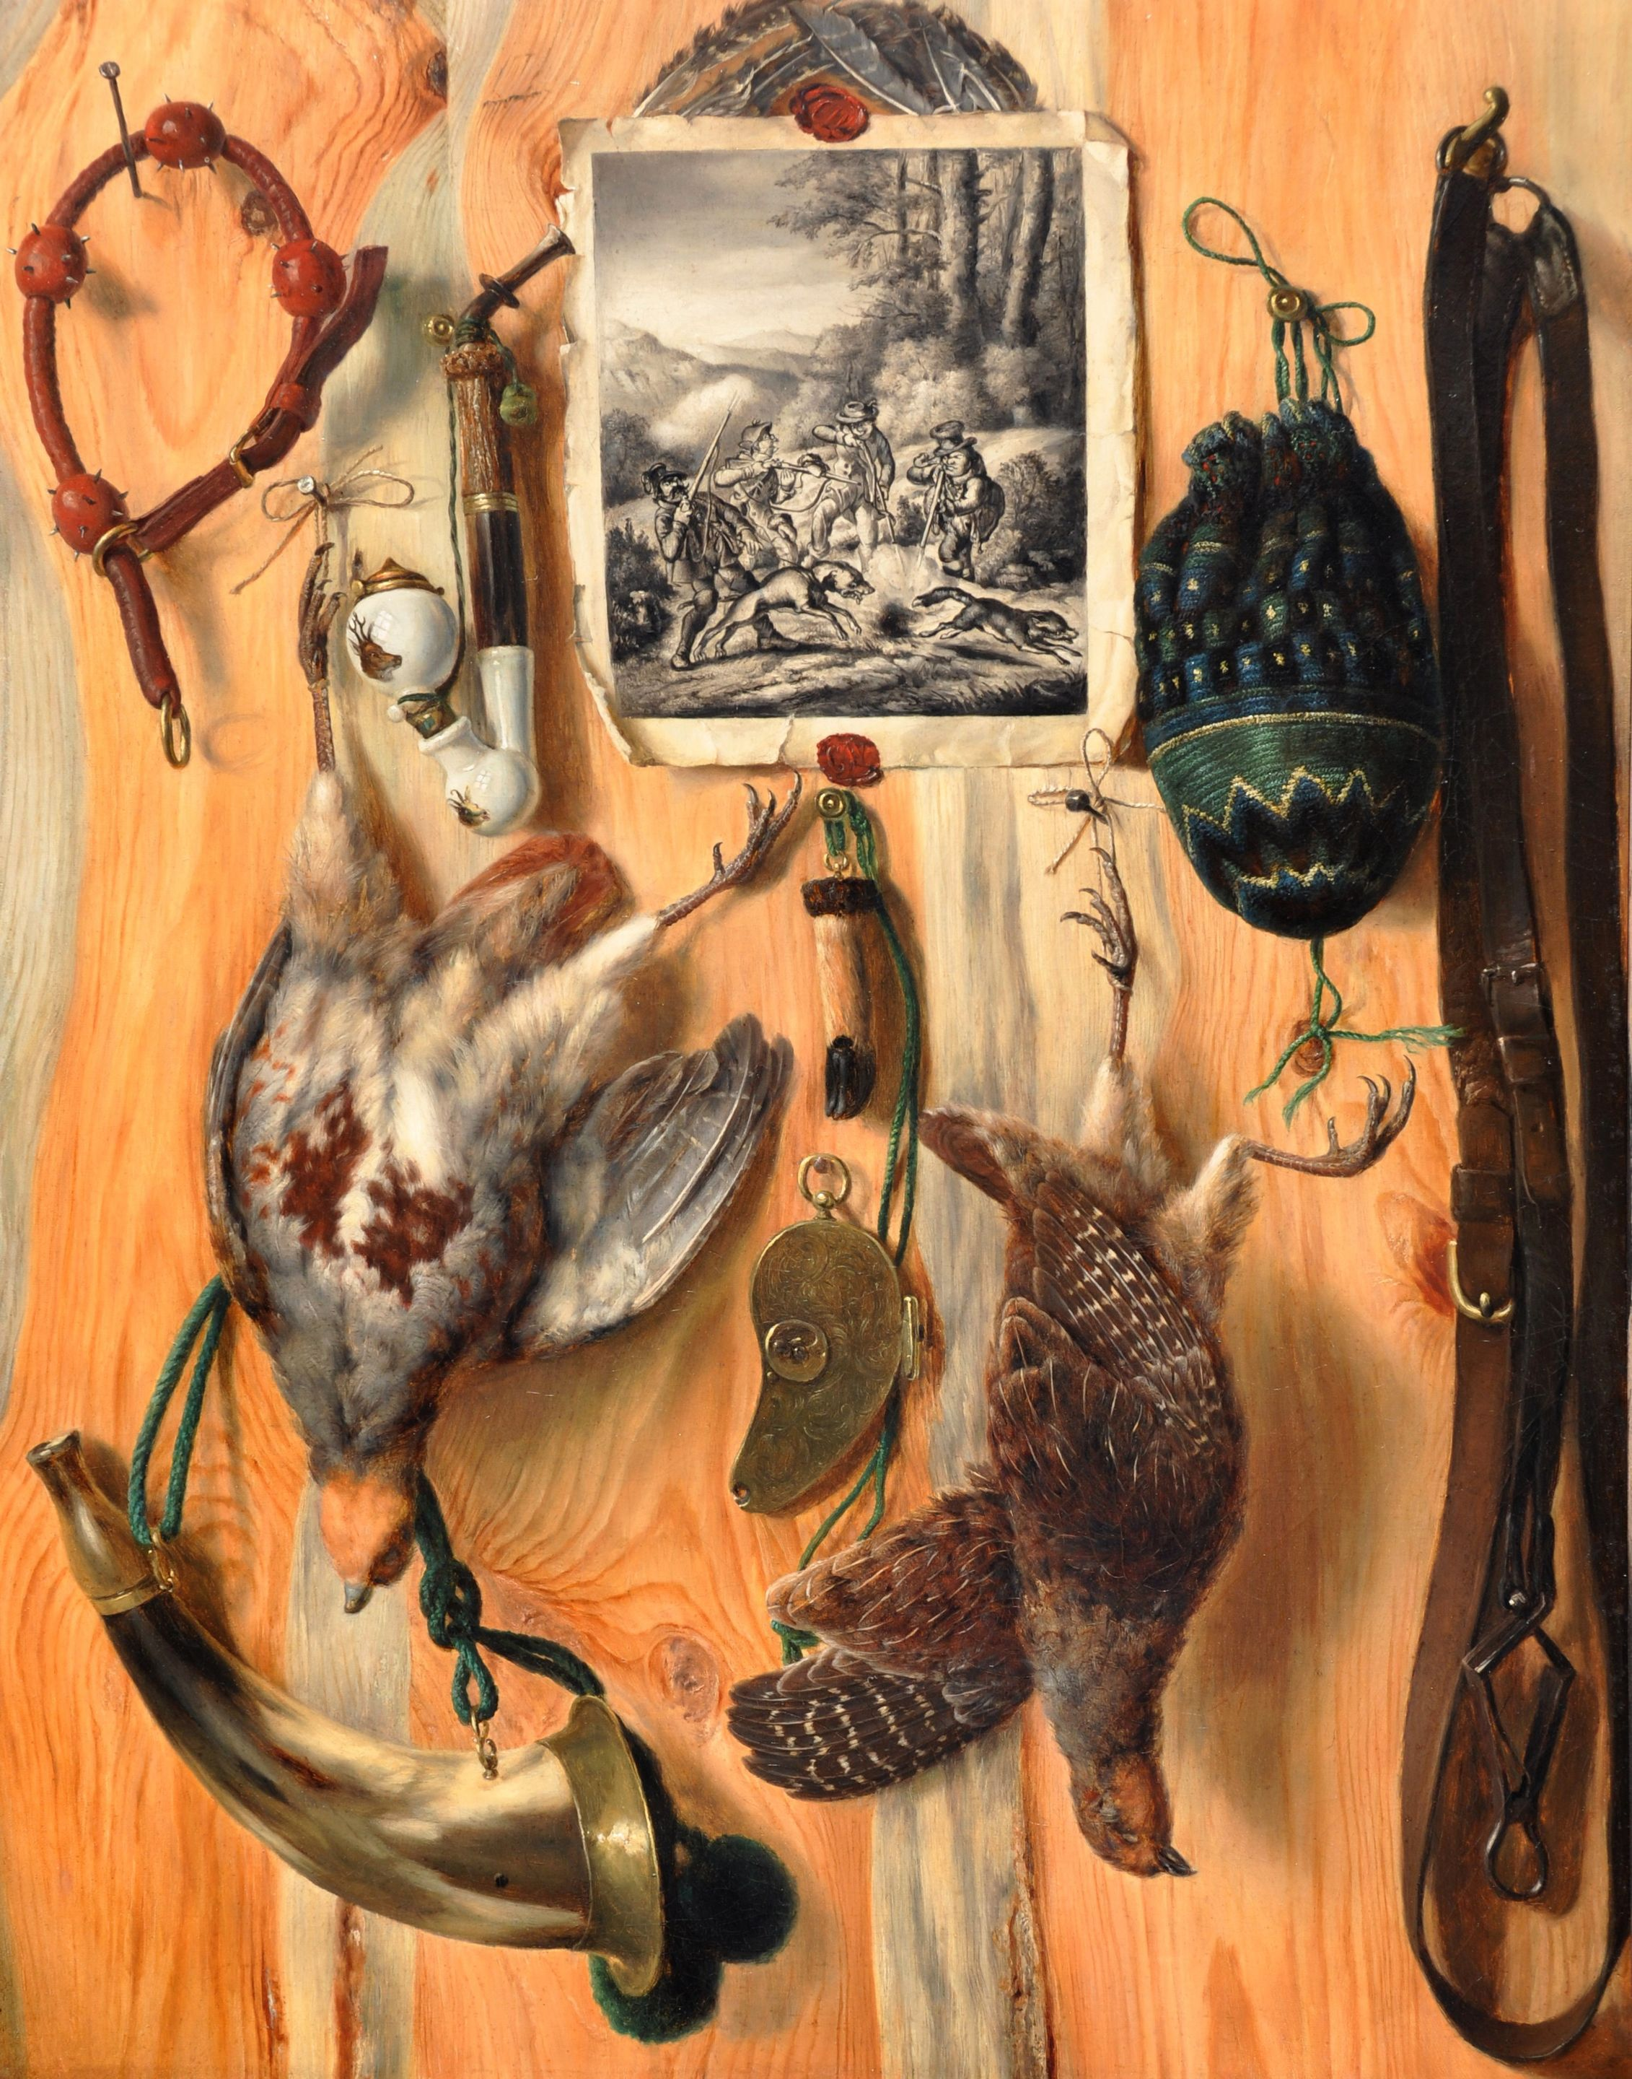
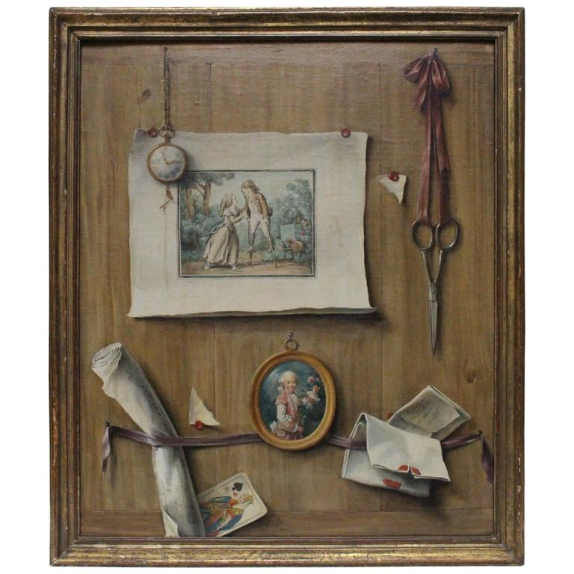
Trompe l’oeil French for “deceive the eye” an art technique that uses realistic imagery to create the optical illusion that the depicted objects exist in three dimensions.

Slide 3
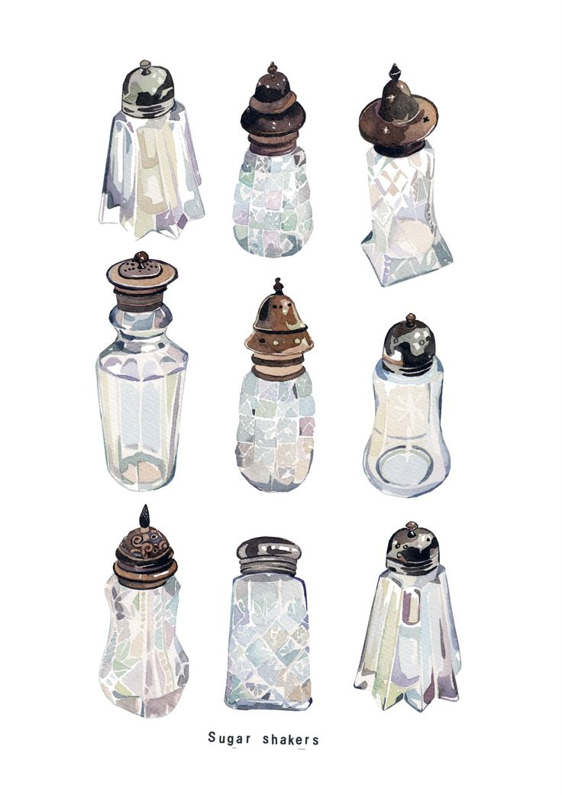
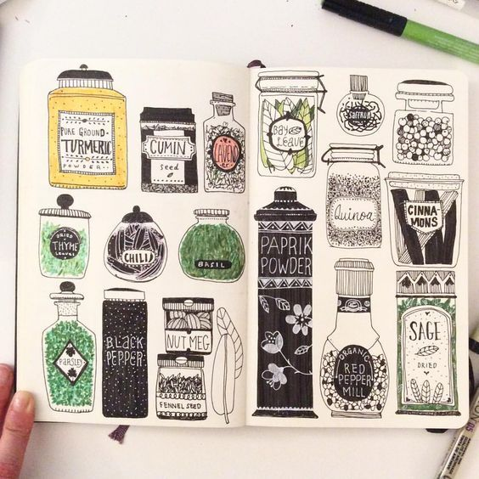
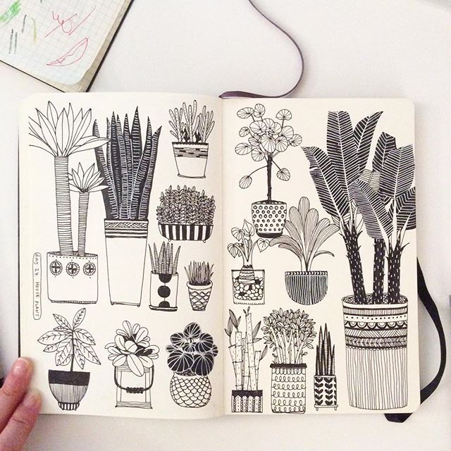
Illustrated collections
Stacked items arranged so you can see each object entirely
Watercolor/Ink/Pen and Ink (Aqueous media)

Slide 4
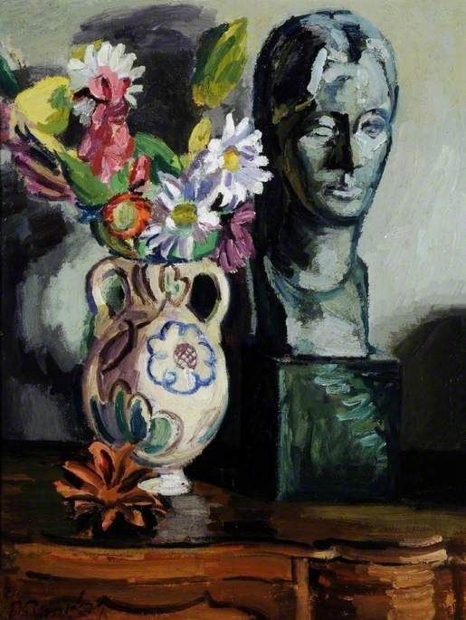
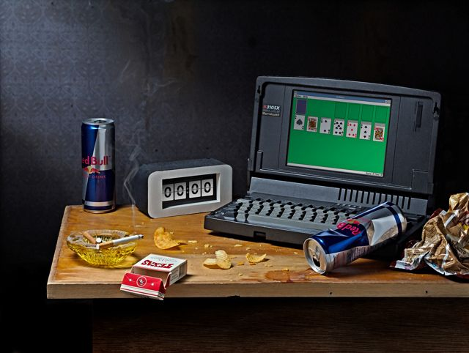
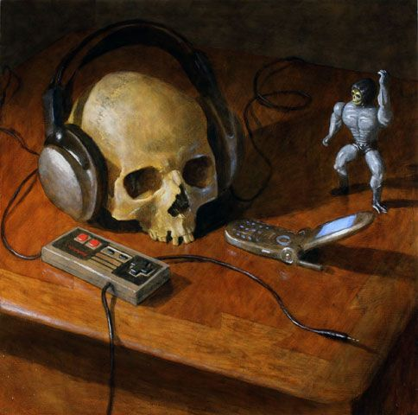
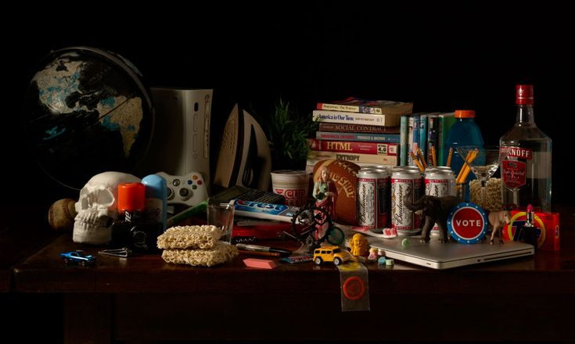
Traditional Still Life
Collection arranged with varying heights and perspectives of objects
“Snapshot” of life—Items should appear as though you caught them in that arrangement, or that life stood still for a moment
Acrylic, oil on canvas or wood board

